Slide 1
Statistical Learning for Classification
Tianhang Zheng
https://tianzheng4.github.io

Slide 2

Quantitative vs Qualitative Outputs
Regression mainly study quantitative outputs
$$Y=β_{0}+β_{1}X_{1}+β_{2}X_{2}+…+β_{p}X_{p}+ε$$
Classification mainly study qualitative outputs
Qualitative variables take values in an unordered set, i.e.,
$$eye color∈\left\{brown, black, green\right\}$$

Slide 3



Why not Linear Regression
Binary Classification: $Y=\{0, 1\}$
$$\hat{y}={\hat{β}}_{0}+{\hat{β}}_{1}x$$
As long as ${\hat{β}}_{1}$ is not zero, the prediction could be larger than 1 or smaller than 0
Logistic regression is more appropriate!

Slide 4


Logistic Regression
$$p(Y=1|X)=\frac{e^{β_{0}+β_{1}X}}{1+e^{β_{0}+β_{1}X}}$$
$p\left(Y=1 | X\right)$ always has values between 0 and 1
$$\log\left(\frac{p}{1−p}\right)=β_{0}+β_{1}X$$

Slide 5
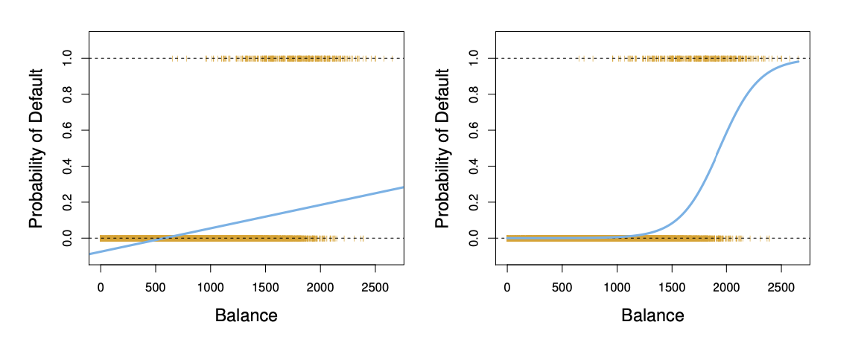
Linear Regression vs Logistic Regression

Slide 6

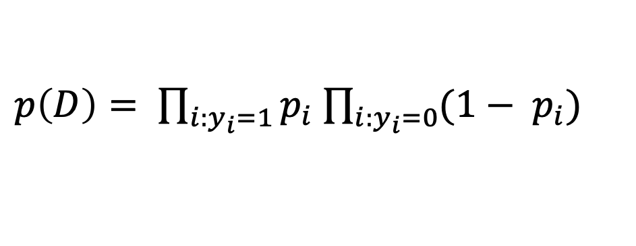
Maximum Likelihood Method
Commonly used for parameter estimation of logistic regression
Assume that the predictors are independent
$p\left(D\right)= \prod_{i:y_{i}=1}{p_{i}}$ $\prod_{i:y_{i}=0}{{(1− p}_{i})}$
$$p_{i}= p(y_{i}=1|x_{i})$$
This likelihood characterizes the probability of the observed data

Slide 7
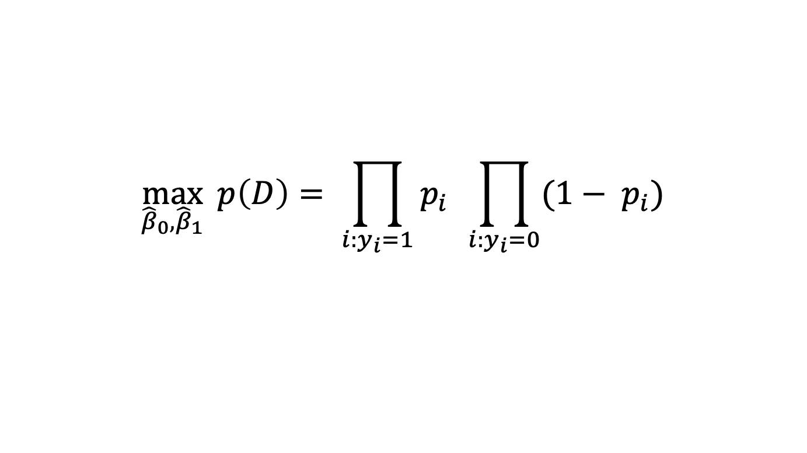
Maximum Likelihood Method
$$\max_{{\hat{β}}_{0},{\hat{β}}_{1}}{ p\left(D\right)= \prod_{i:y_{i}=1}{p_{i}} \prod_{i:y_{i}=0}{{(1− p}_{i})}}$$
May need to use an optimizer to solve the problem
In practice, we could use sklearn.linear_model.LogisticRegression

Slide 8

Multi-Class Logistic Regression
A linear function for each class
$$p(Y=k|X)=\frac{e^{β_{0k}+β_{1k}X}}{\sum_{l=1}^{K}{e^{β_{0l}+β_{1l}X}}}$$
Multi-class logistic regression is also called multinomial regression

Slide 9

Discriminant Analysis
Model the data distribution for each class as Gaussian distribution
Use the Bayes theorem to obtain $p(Y|X)$
$$p\left(Y=y | X=x\right)=\frac{p\left(X=x | Y=y\right)p(Y=y)}{p(X=x)}$$

Slide 10


Discriminant Analysis
$$p\left(Y=k | X=x\right)=\frac{p\left(X=x | Y=k\right)p(Y=k)}{p(X=x)}$$
Prior distribution: $π_{k}=p(Y=k)$
Data density for class k: $f_{k}(x)=p\left(X=x | Y=k\right)$
$$p\left(Y=k | X=x\right)=\frac{π_{k}f_{k}(x)}{\sum_{l=1}^{K}{π_{l}f_{l}(x)}}$$

Slide 11

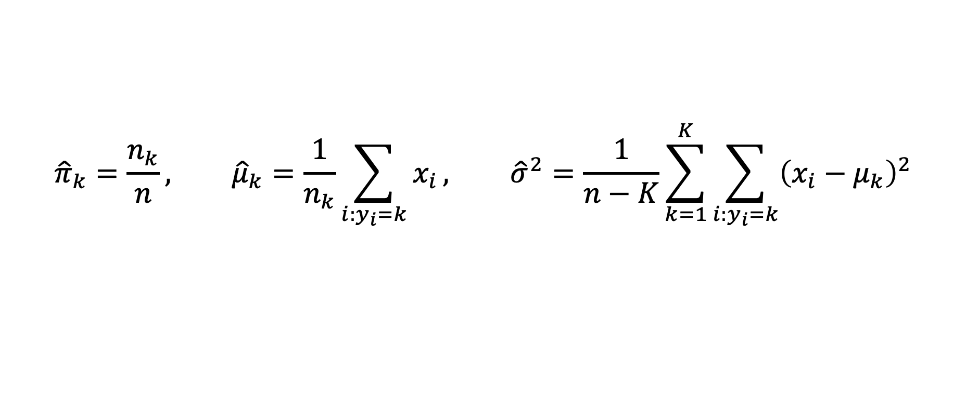
Discriminant Analysis
Model the data distribution for each class as Gaussian distribution
$$f_{k}(x)=\frac{1}{\sqrt{2πσ_{k}}}e^{−\frac{1}{2}{\left(\frac{x−μ_{k}}{σ_{k}}\right)}^{2}}$$
Use the data from class k to estimate the mean and standard deviation
$${\hat{π}}_{k}=\frac{n_{k}}{n}, {\hat{μ}}_{k}=\frac{1}{n_{k}}\sum_{i:y_{i}=k}{x_{i}}, {\hat{σ}}^{2}=\frac{1}{n−K}\sum_{k=1}^{K}{\sum_{i:y_{i}=k}{{\left(x_{i}−μ_{k}\right)}^{2}}}$$

Slide 12

Discriminant Analysis
Classify $x$ as $k$ with the largest probability $p_{k}(x)$
$$p_{k}(x)=\frac{π_{k}\frac{1}{\sqrt{2πσ}}e^{−\frac{1}{2}{\left(\frac{x−μ_{k}}{σ_{k}}\right)}^{2}}}{\sum_{l=1}^{K}{π_{l}\frac{1}{\sqrt{2πσ}}e^{−\frac{1}{2}{\left(\frac{x−μ_{l}}{σ_{l}}\right)}^{2}}}}$$
Discriminant score
$$δ_{k}\left(x\right)=x\frac{μ_{k}}{σ^{2}}−\frac{μ_{k}^{2}}{{2σ}^{2}}+log⁡(π_{k})$$

Slide 13
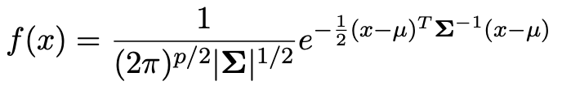
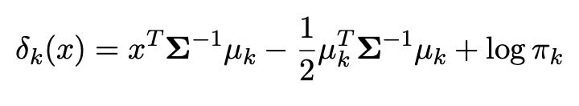
Multi-Variable Discriminant Analysis

Slide 14
Q & A

